Slide 1
BILLIONARIES - 2023

Slide 2
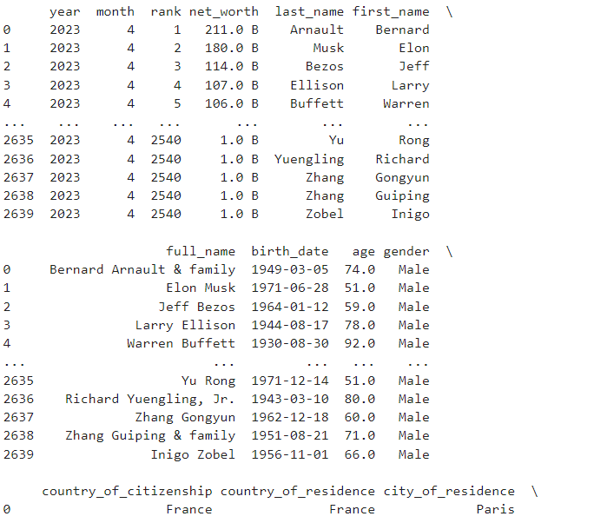
IMPORT FILE
CODE:
import pandas as pd
df = pd.read_csv('billionaires_2023.csv')print(df)

Slide 3
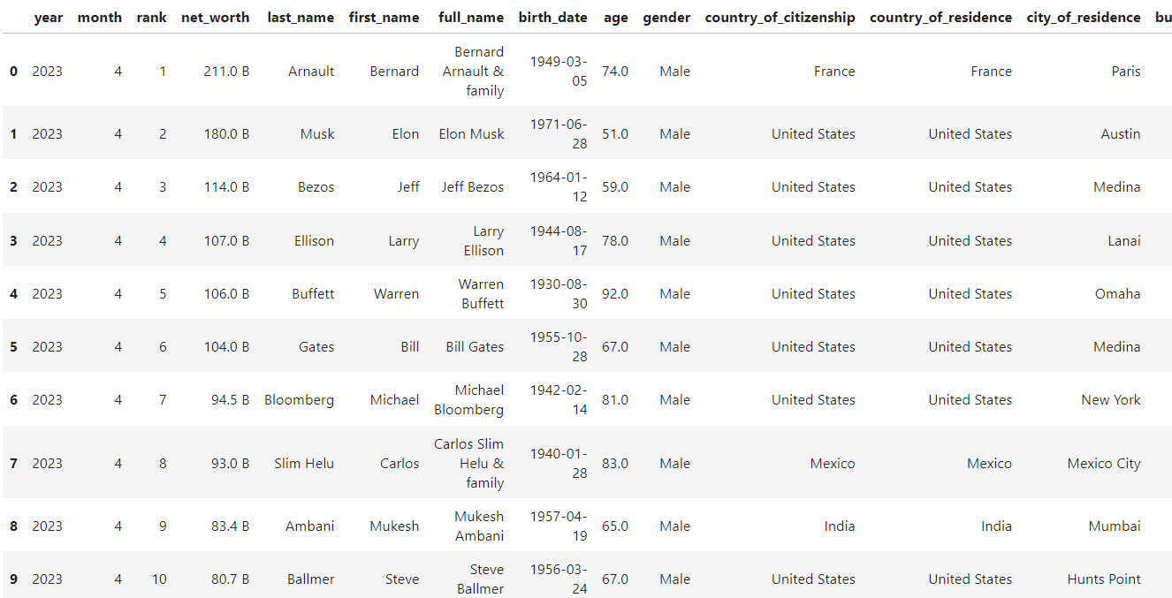
TOP 10 BILLIONARIES
CODE:
df.head(10)

Slide 4
MEAN NET WORTH
CODE:
import pandas as pd
# Read data into a DataFrame
df= pd.read_csv('billionaires_2023.csv’)
# Convert the 'net_worth' column to numeric (removing the 'B' suffix)
df['net_worth'] = df['net_worth'].replace({'B': ''}, regex=True).astype(float)
# Calculate the mean of 'net_worth' column
mean_net_worth = df['net_worth'].mean()
print("Mean net worth:")
print(mean_net_worth)
OUTPUT:
Mean net worth:
4.6237878787878

Slide 5
MEAN OF AGE
CODE:
import numpy as np
import pandas as pd
# Read data into a DataFrame
df= pd.read_csv('billionaires_2023.csv’)
mean_of_age=df['age’]
# Mean
mean = np.mean(mean_of_age)
print("Mean of age:", mean)
OUTPUT:
Mean of age:
65.13902912621359

Slide 6
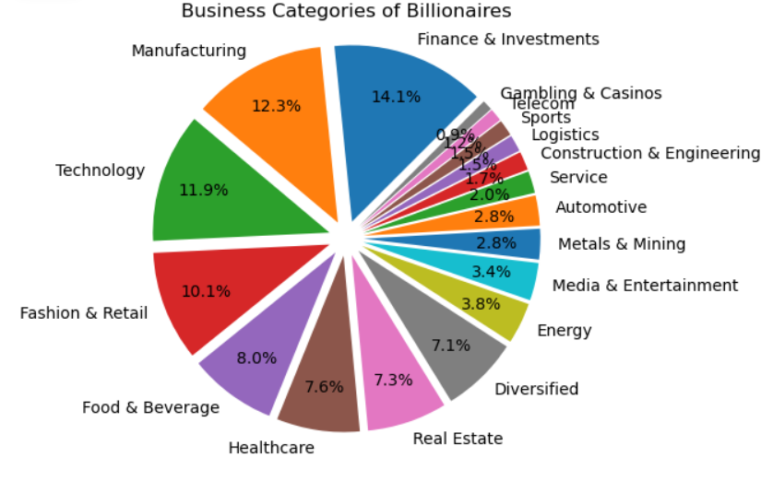
Business categories of Billionaires – Pie Chart
CODE:
import pandas as pd
import matplotlib.pyplot as plt
# Read data into a DataFrame
df = pd.read_csv('billionaires_2023.csv’)
# Clean data: remove any rows with missing values in 'business_category' column
df = df.dropna(subset=['business_category’])
# Extracting business category counts
business = df['business_category'].value_counts()
# Labels for the pie chart
labels = business.index
# Data for the pie chart
sizes = business.values
# Explode parameter
explode = tuple([0.1] * len(labels))
# Explode all slices slightly for emphasis
# Plotting the pie chart
plt.pie(sizes, explode=explode, labels=labels, autopct='%1.1f%%', startangle=45, pctdistance=0.75)
plt.title("Business Categories of Billionaires")
# Equal aspect ratio ensures that pie is drawn as a circle
plt.axis('equal’)
# Show the plot
plt.show()

Slide 7
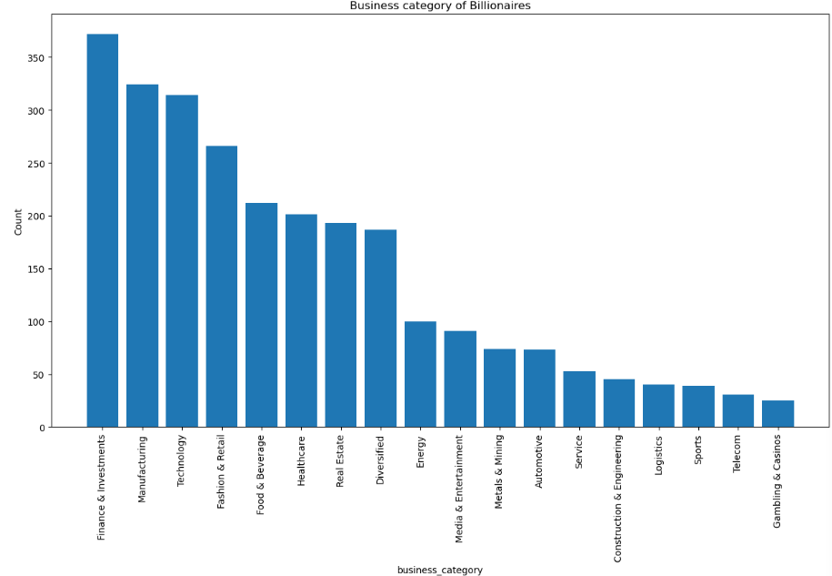
Business categories of Billionaires – Bar Chart
CODE:
import pandas as pd
import matplotlib.pyplot as plt
# Read data into a DataFrame
df = pd.read_csv('billionaires_2023.csv’)
# Extracting business category counts
business = df['business_category'].value_counts()
# Plotting a bar chart
# Plotting
plt.figure(figsize=(15, 8))
plt.bar(business.index, business.values)
# Rotation of the bars names
plt.xticks(rotation=90)
# Title and labels
plt.title("Business category of Billionaires")
plt.xlabel("business_category")
plt.ylabel("Count")
# Show plot
plt.show()

Slide 8
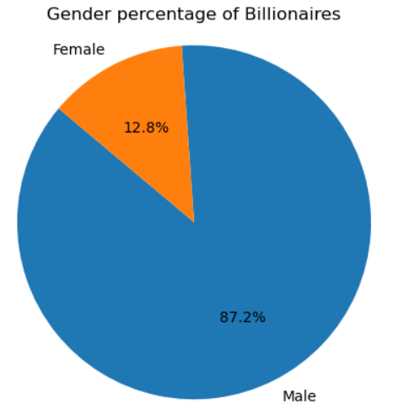
Gender percentage of Billionaires
CODE:
import pandas as pd
import matplotlib.pyplot as plt
# Read data into a DataFrame
df = pd.read_csv('billionaires_2023.csv’)
# Assuming the DataFrame contains a 'gender' column
# Extracting gender counts
gender_counts = df['gender'].value_counts()
# Labels for the pie chart
labels = gender_counts.index
# Data for the pie chart
sizes = gender_counts.values
# Explode parameter
explode = (0, 0)
# Plotting the pie chart
plt.pie(sizes, explode=explode, labels=labels, autopct='%1.1f%%', startangle=140)
# Title for the plot
plt.title("Gender percentage of Billionaires")
# Equal aspect ratio ensures that pie is drawn as a circle
plt.axis('equal’)
# Show the plot
plt.show()

Slide 9
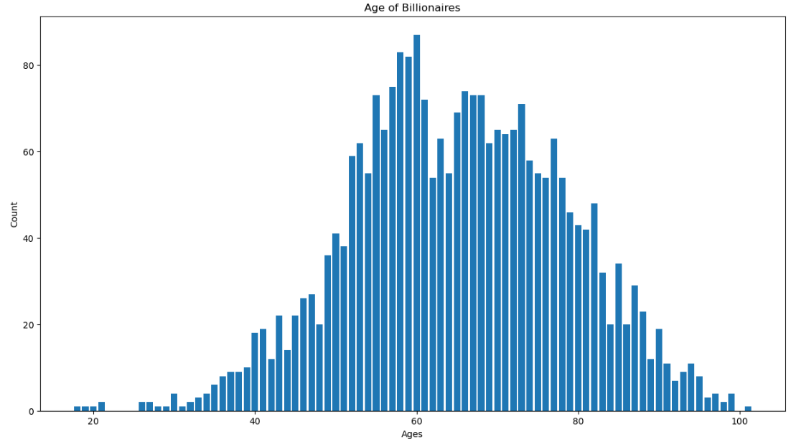
AGE OF BILLIONARIES
CODE:
import pandas as pd
import matplotlib.pyplot as plt
# Read data into a DataFrame
df = pd.read_csv('billionaires_2023.csv’)
# Assuming the DataFrame contains a 'age' column
# Extracting gender counts
age_counts = df['age'].value_counts()
# Plotting a bar chart
# Plotting
plt.figure(figsize=(15, 8))
plt.bar(age_counts.index, age_counts.values)
# Title and labels
plt.title("Age of Billionaires")
plt.xlabel("Ages")
plt.ylabel("Count")
# Show plot
plt.show()

Slide 10
THANK YOU!

